Slide 1
Restaurant Services
Spring Boot 301 Project
Arjun Dhingra
M1050760
Engineer

Slide 2
Problem Description
A global hospitality company looking for a team who can help them in building rapid APIs to access their chain of restaurants and manage orders. APIs should be deployed and hosted independently based on following service category. This should help their customers to use on need basis:
Restaurant Search Service
Order Management Service

Slide 3
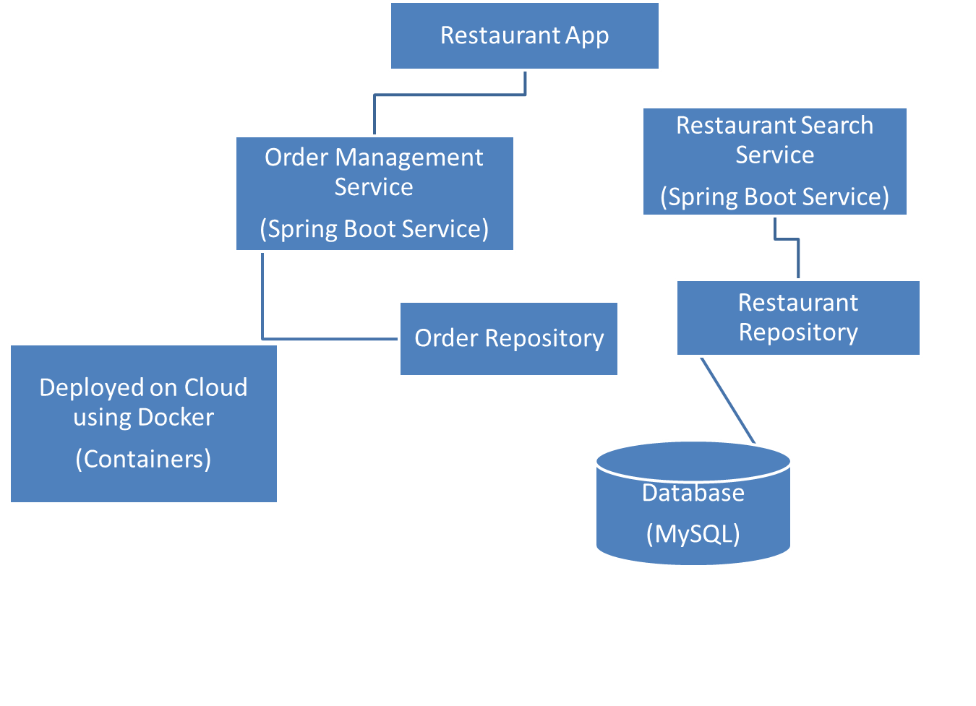
Architecture Diagram

Slide 4
Technology Stack
Spring Boot
Spring Boot enables building production-ready applications quickly and provides non-functional features:
Embedded servers which are easy to deploy with the containers.
It helps in monitoring the multiples components.
It helps in configuring the components externally.

Slide 5
MySQL Workbench
MySQL Workbench is a graphical tool for working with MySQL servers and databases.
MySQL Workbench functionality covers five main topics:
SQL Development: Enables you to create and manage connections to database servers. Along with enabling you to configure connection parameters, MySQL Workbench provides the capability to execute SQL queries on the database connections using the built-in SQL Editor.
Data Modeling (Design): Enables you to create models of your database schema graphically, reverse and forward engineer between a schema and a live database, and edit all aspects of your database using the comprehensive Table Editor. The Table Editor provides easy-to-use facilities for editing Tables, Columns, Indexes, Triggers, Partitioning, Options, Inserts and Privileges, Routines and Views.
Server Administration: Enables you to administer MySQL server instances by administering users, performing backup and recovery, inspecting audit data, viewing database health, and monitoring the MySQL server performance.

Slide 6
Functional Requirements (Features)
Restaurant Search Service
In this service, customer is able to search for the restaurant based on certain filters:
  Based on location
  Distance
  Cuisine
  Budget
  Ratings
  Restaurant name

Slide 7
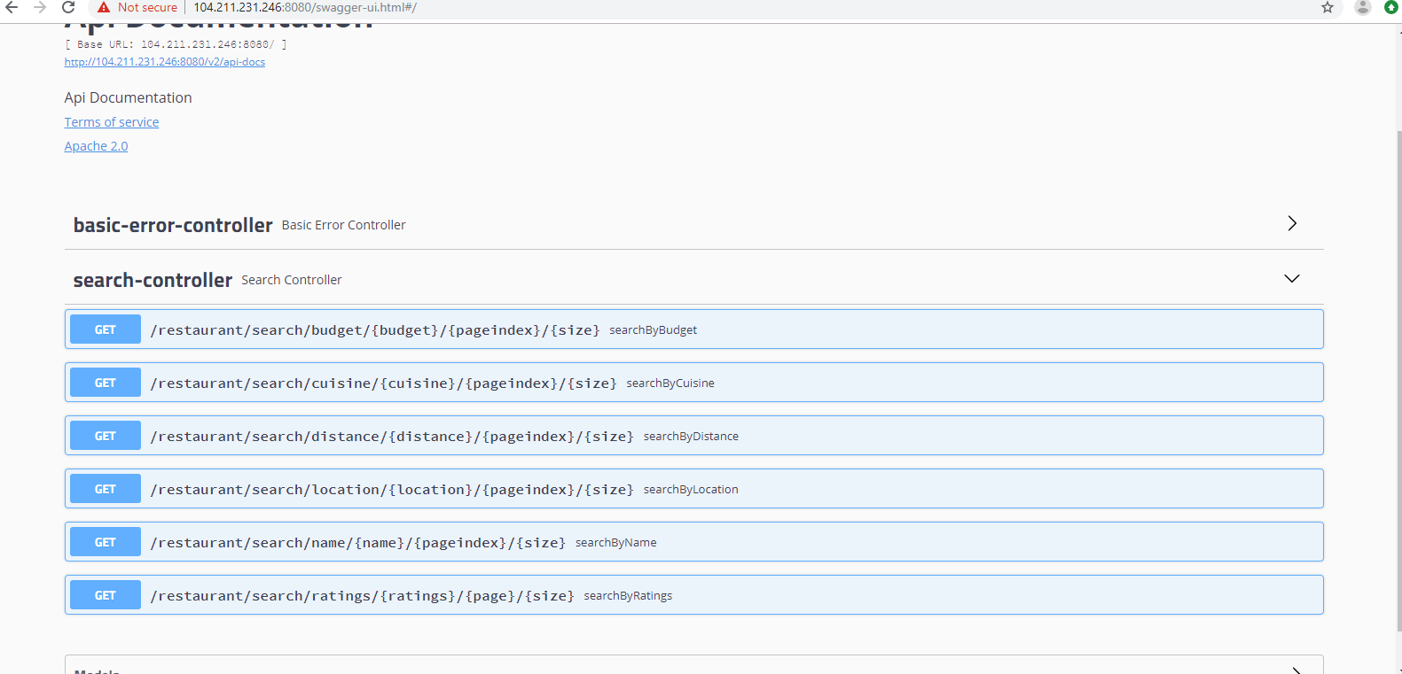

Slide 8
Order Management Service
In this service, customer is able to:
  Place order
  Update order
  Cancel order
  View order
  Calculating the total amount based on the number of items ordered

Slide 9
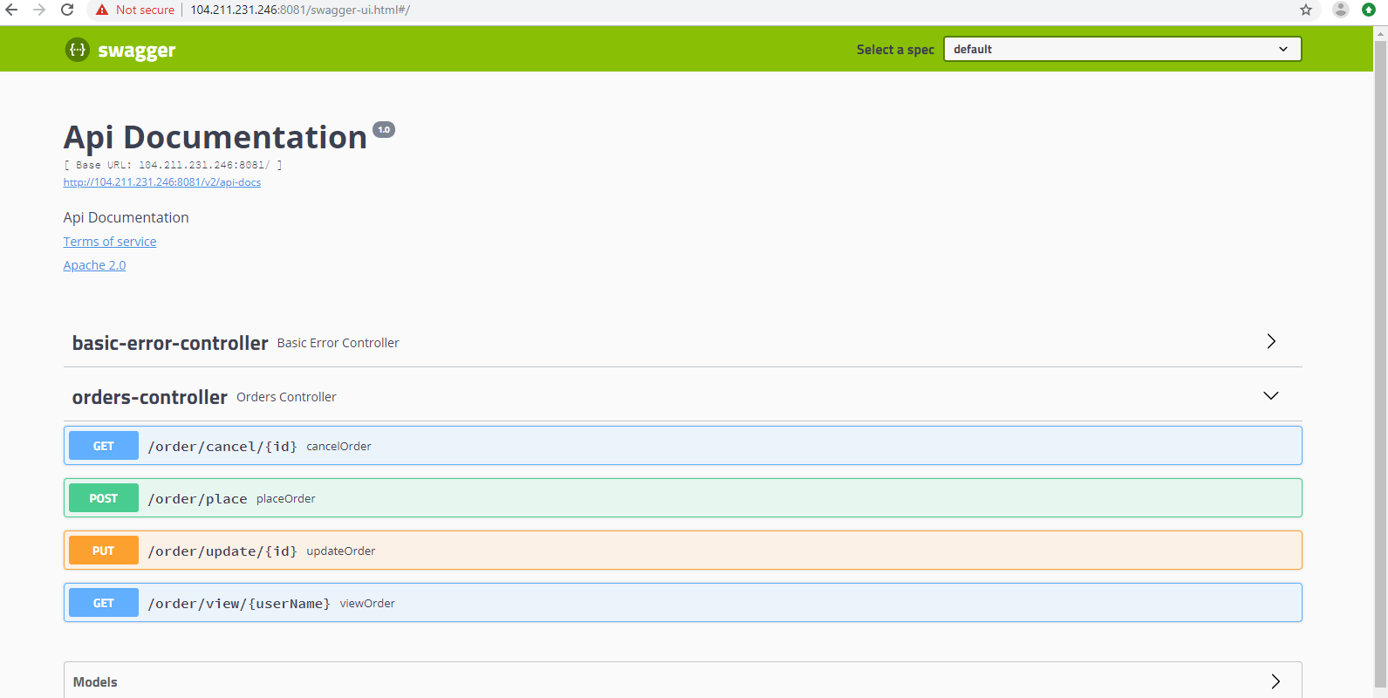

Slide 10
Non Functional Requirements
All the services have been deployed as containers on Azure cloud using Docker.
Performance
  The search service is completed within 200 Milliseconds. This has been done using spring boot caching.
  Ordering of food is completed within 3000 Milliseconds.

Slide 11
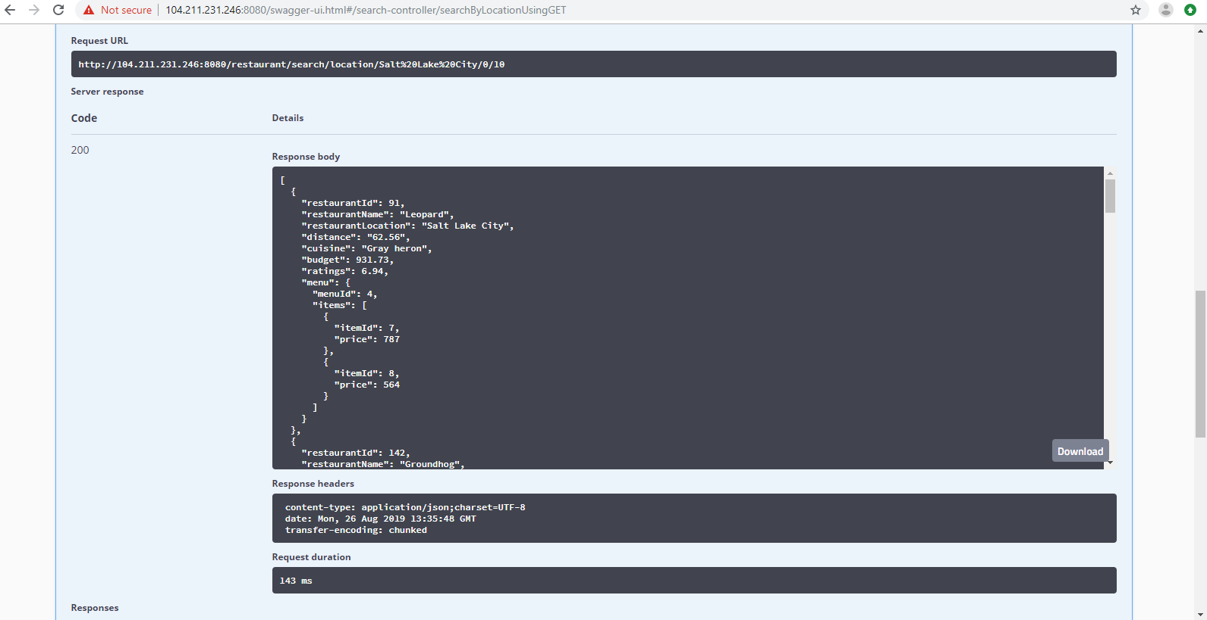

Slide 12
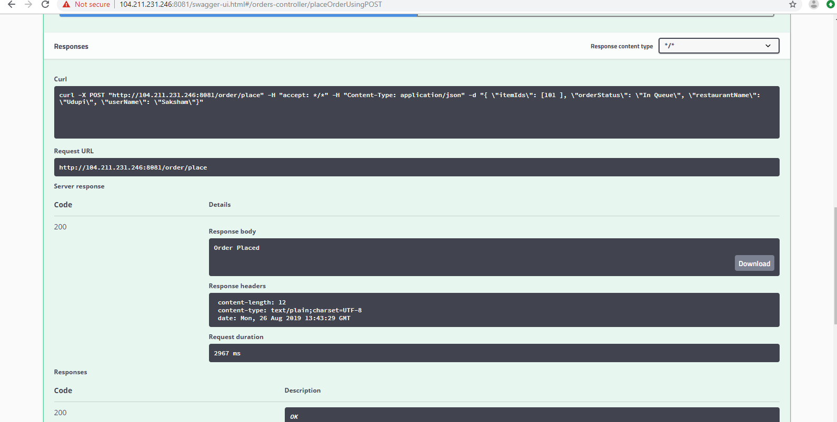

Slide 13
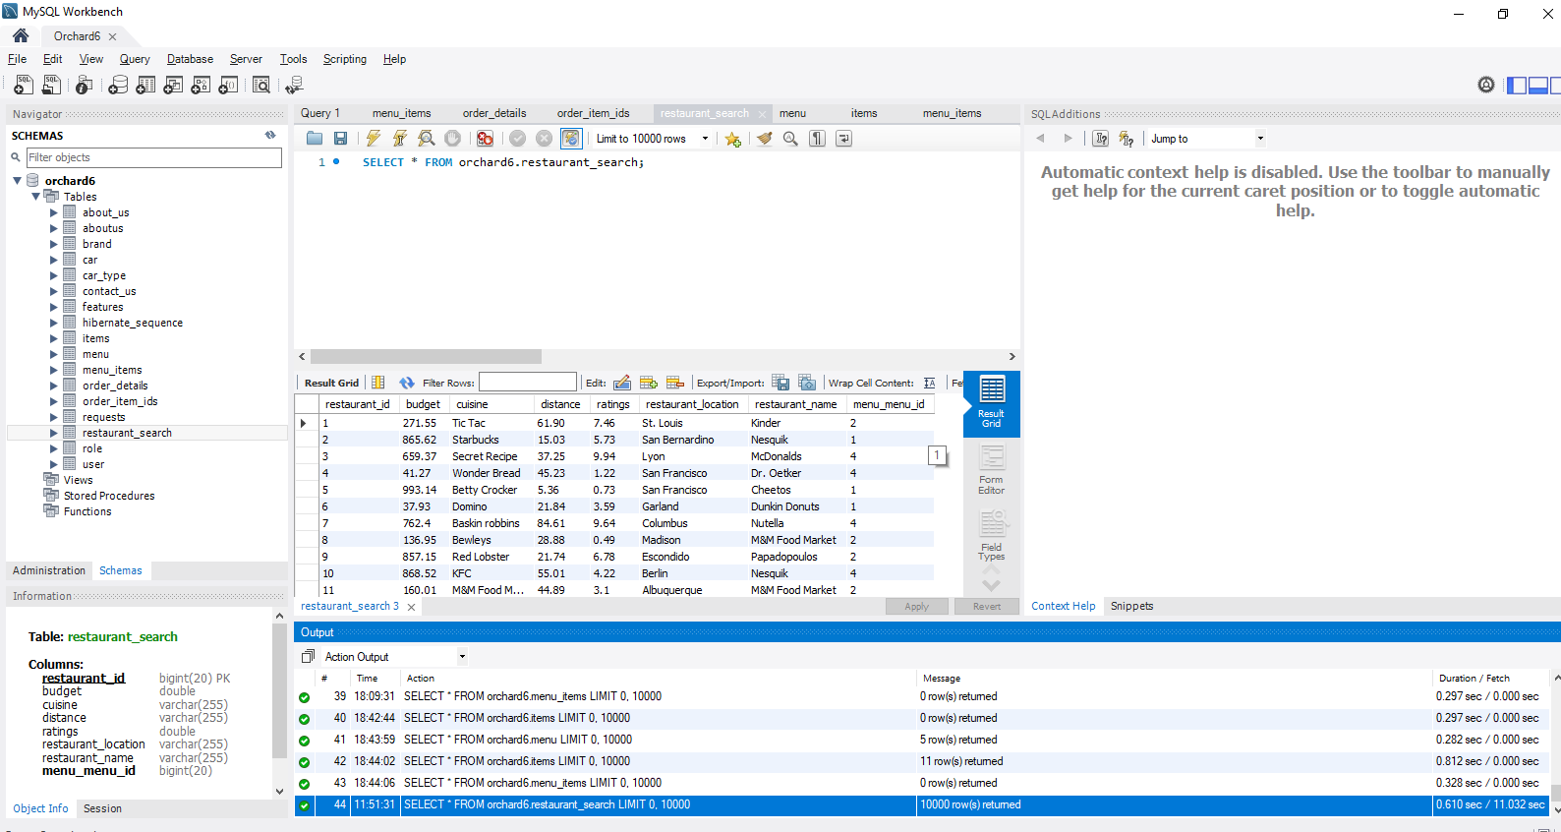
Scalability
  The application supports for 10000+ restaurants.

Slide 14
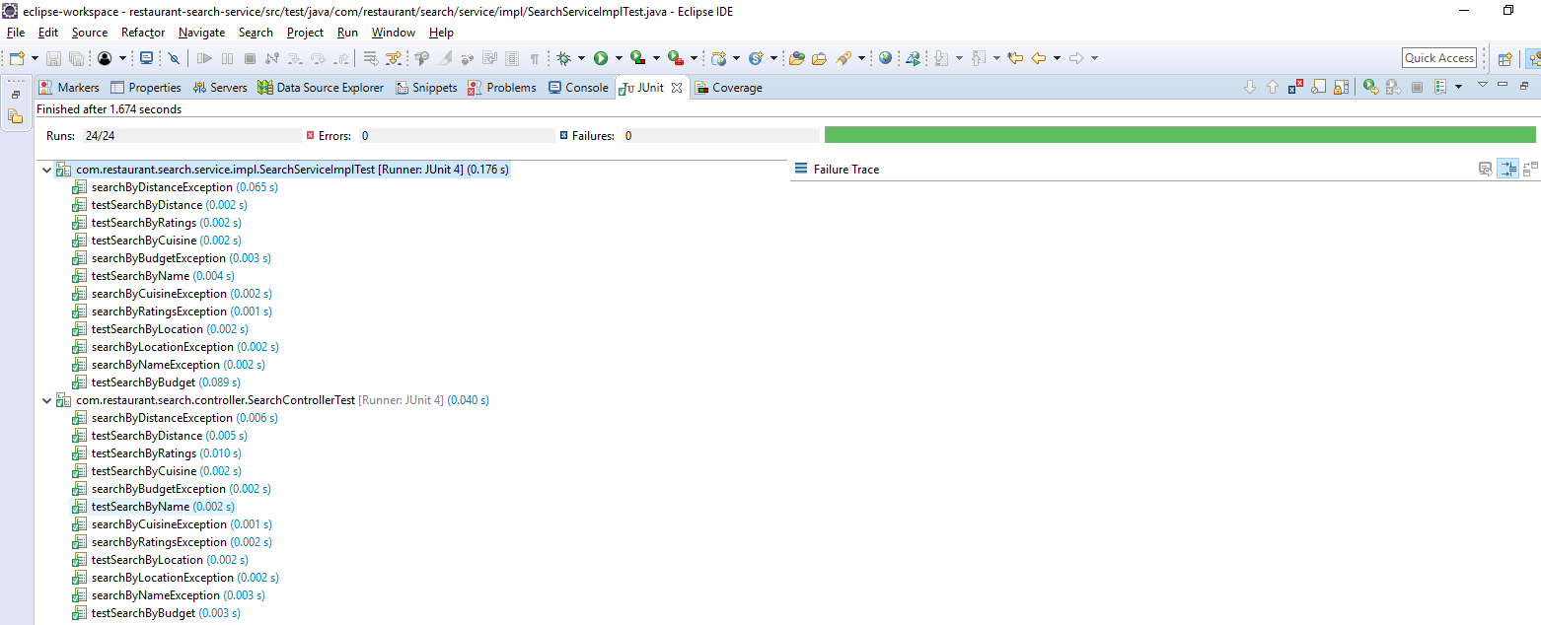
Test Driven Development
  The application has a code coverage of 90% and above.

Slide 15
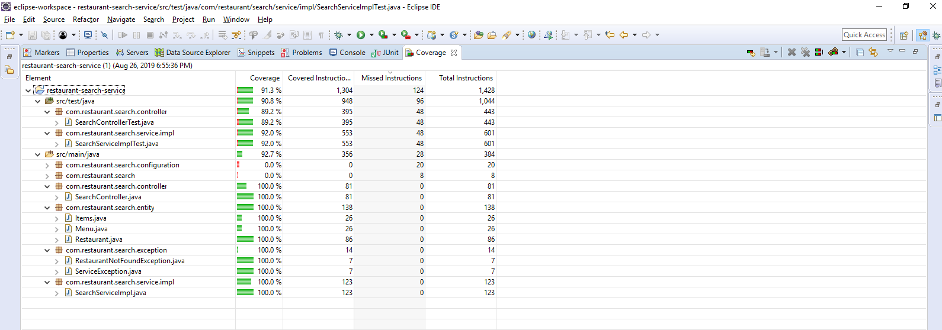

Slide 16
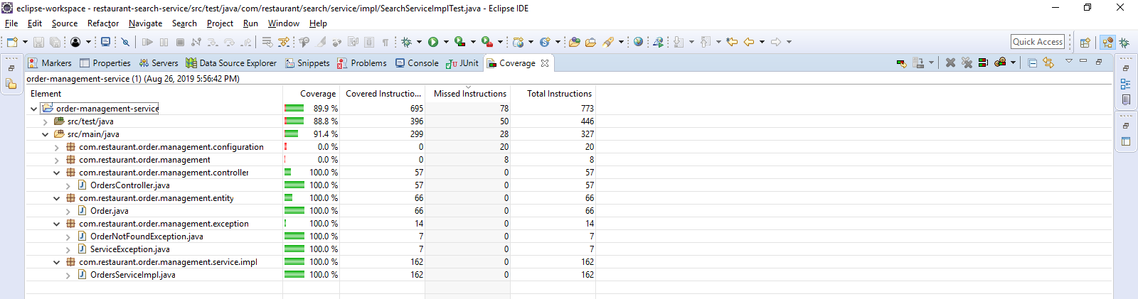

Slide 17
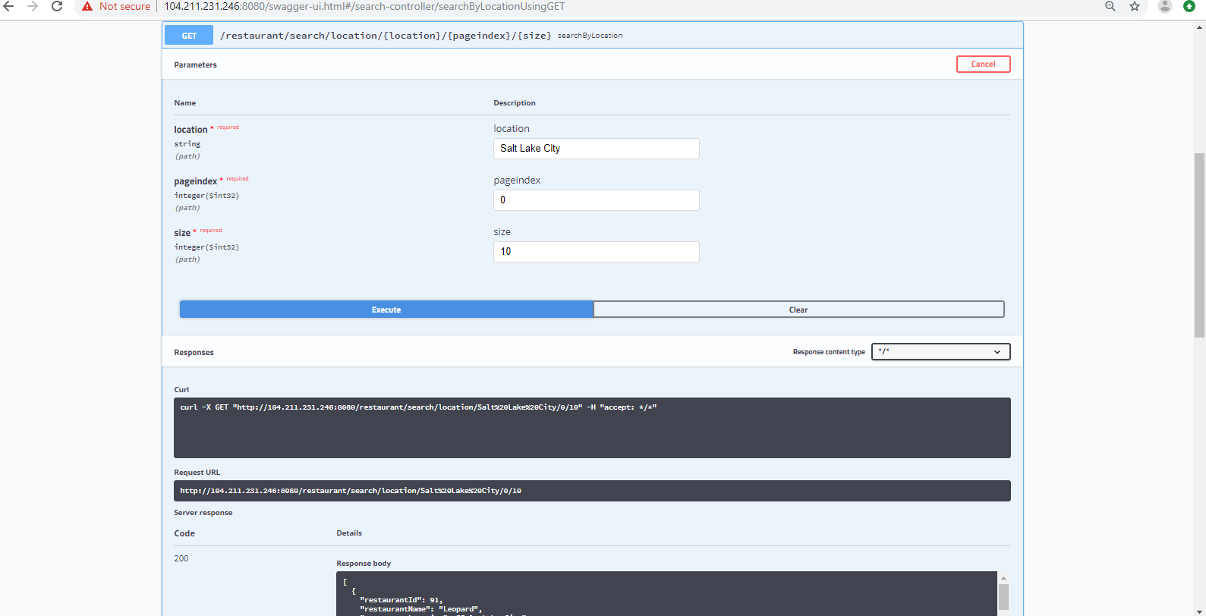
Pagination
  The application has a support for pagination.

Slide 18
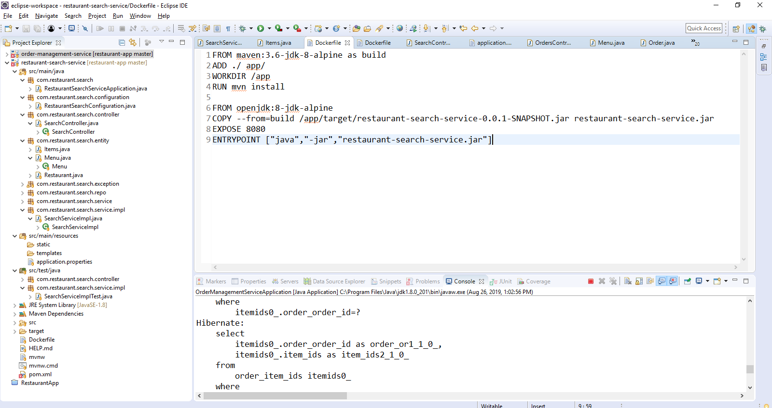
Deployment Details
Dockerfile for deployment to Cloud

Slide 19
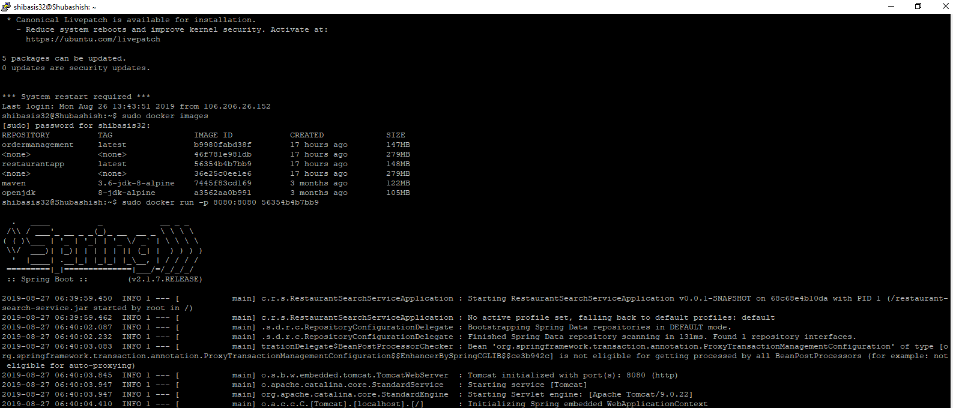
Docker images generated for each container. Each container has a different service.

Slide 20
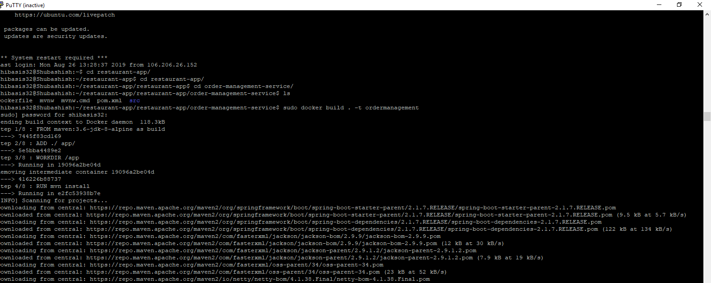
Dockerfile running in VM instance

Slide 21
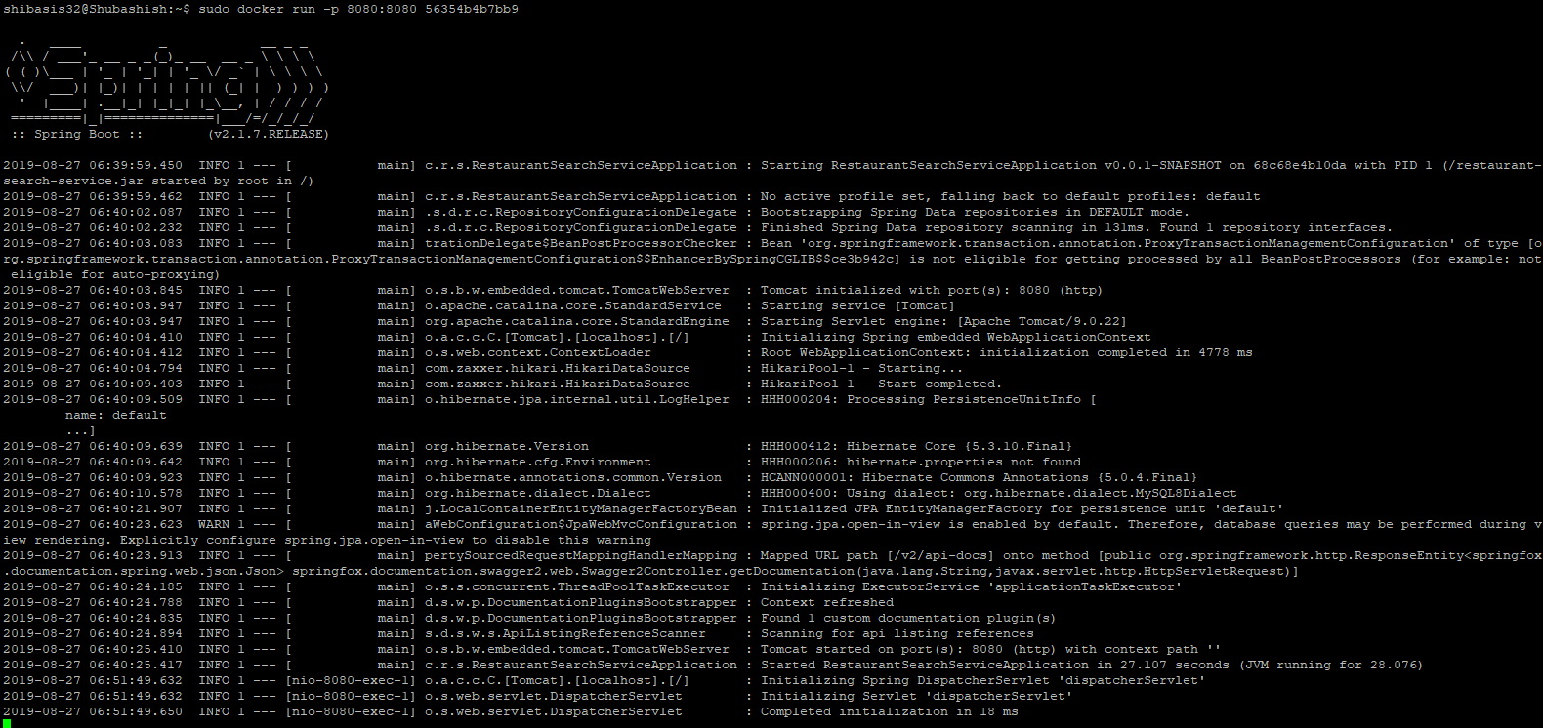
Running app in cloud in docker container

Slide 22
Scope for Future Enhancement
Payment- We can enable payment through net banking, online payment services and credit/debit cards. There will be no requirement to make use of cash.
Mobility and Ease- With the increase in usage of smartphones, mobile application can be developed.
Smart Suggestions- According to the customer order history, their favorites and demands can be identified and suggestions can be provided.
Discounts- To increase the sales and get more customers heavy discounts can be provided on food items by contacting the restaurant owners.

